Slide 3
Please click here for a short video.

Slide 5
Airport information is here.

Slide 8
Hangar Hotel info is here.

Slide 9
Hotel info is here.

Slide 11
Museum info is here.

Slide 12
Info here.
Info here.
Info here.
Info here.

Slide 13
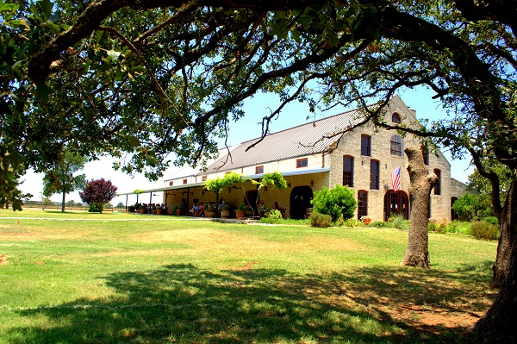
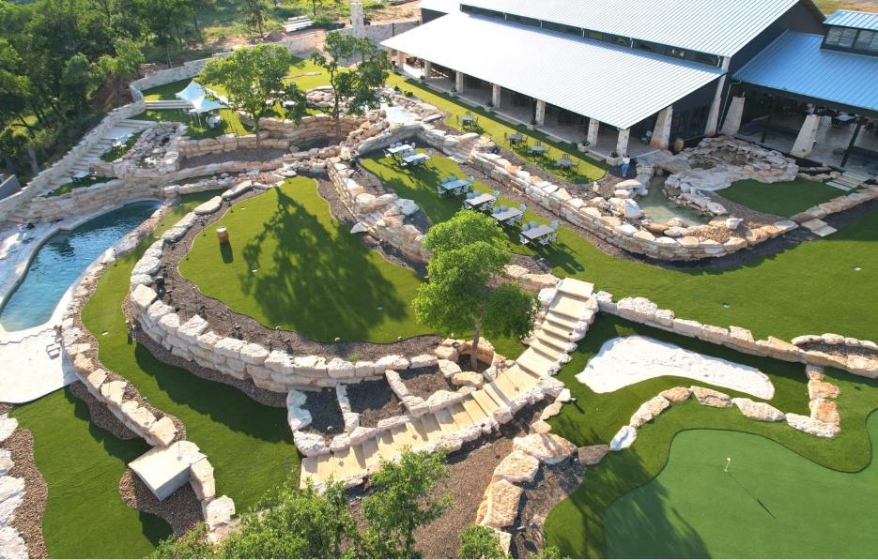
Optional: Wednesday afternoon Wine Tasting Tour
Resort at Fredericksburg info here.
The Edge at The Resort
Becker Vineyards
Transportation to both wineries, all wine tastings,
the winery tour, and a free Reidel wine glass
are included in the price of the activity.
Note: pre-registration is required.

Slide 14
Wildseed Farms info here.

Slide 16
Fredericksburg tourism info is here.

Slide 21
Enchanted Rock State Natural Area info is here.

Slide 22
Luckenbach info is here.

Slide 23
Bat Cave info is here.
Alamo Springs Café info is here.

Slide 24
Texas White House info is here.

Slide 25
Garrison Brothers info is here.

Slide 26
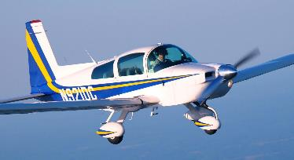
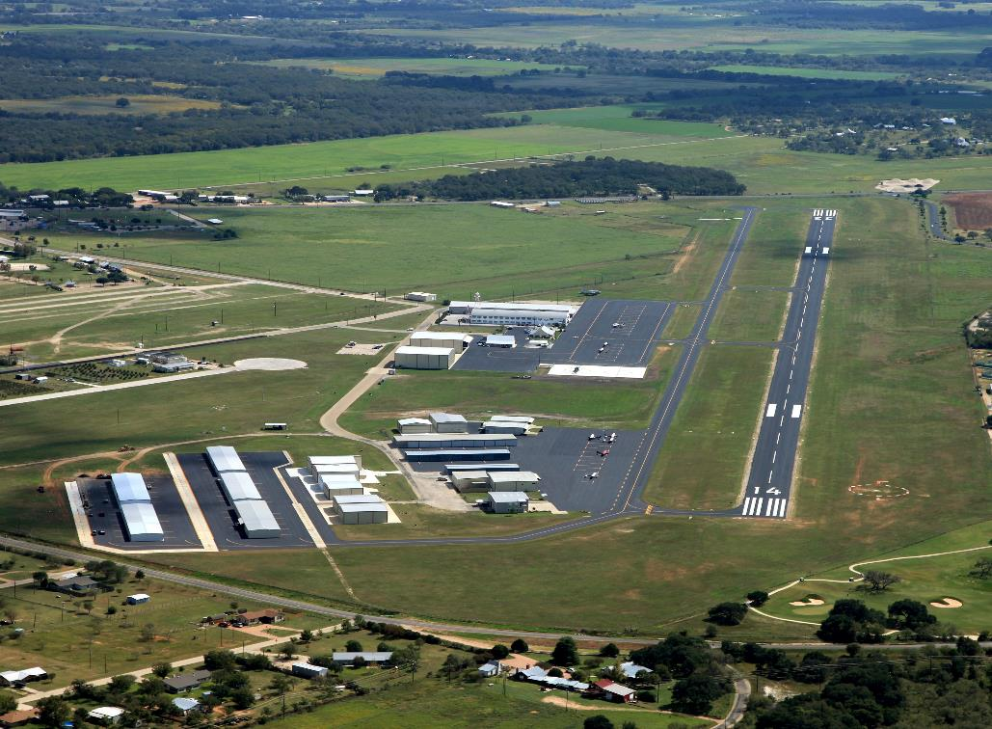
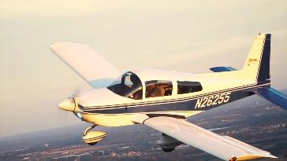
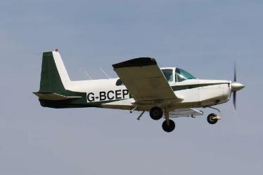
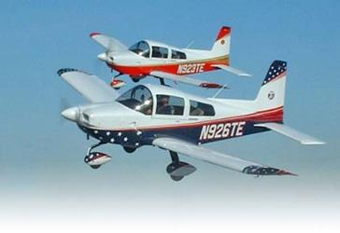
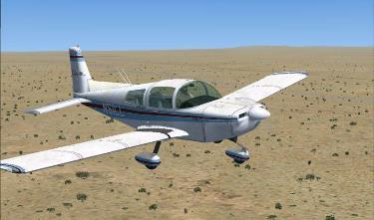
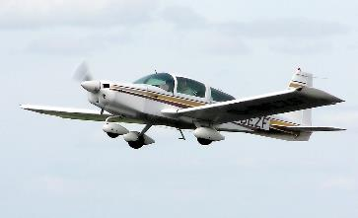
As you can see, there’s a lot to do while attending
the 2022 GOPA Convention!

