Slide 1
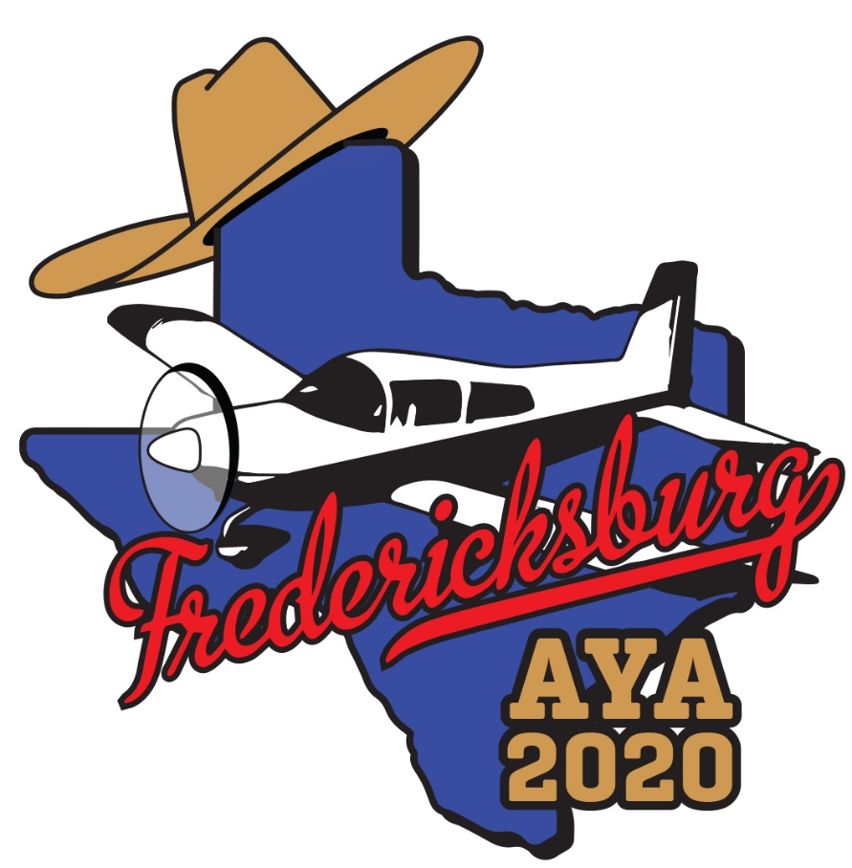
AYA 2020 CONVENTION
May 11-15, 2020
Fredericksburg, Texas

Slide 2
WELCOME TO FREDERICKSBURG, TEXAS - The heart of the Texas hill country

Slide 3
You can get here from there!
Fletchair 12 nm
Brunswick, ME 1601 nm
Calgary, AB, CA 1420 nm
Chicago, IL 882 nm
Denver, CO 642 nm
Los Angeles, CA 1017 nm
Miami, FL 1023 nm
Seattle, WA 1495 nm
Washington, DC 1179 nm
t82
t82

Slide 4
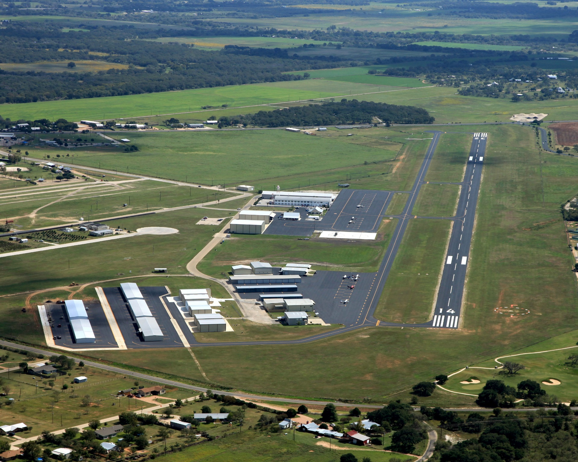
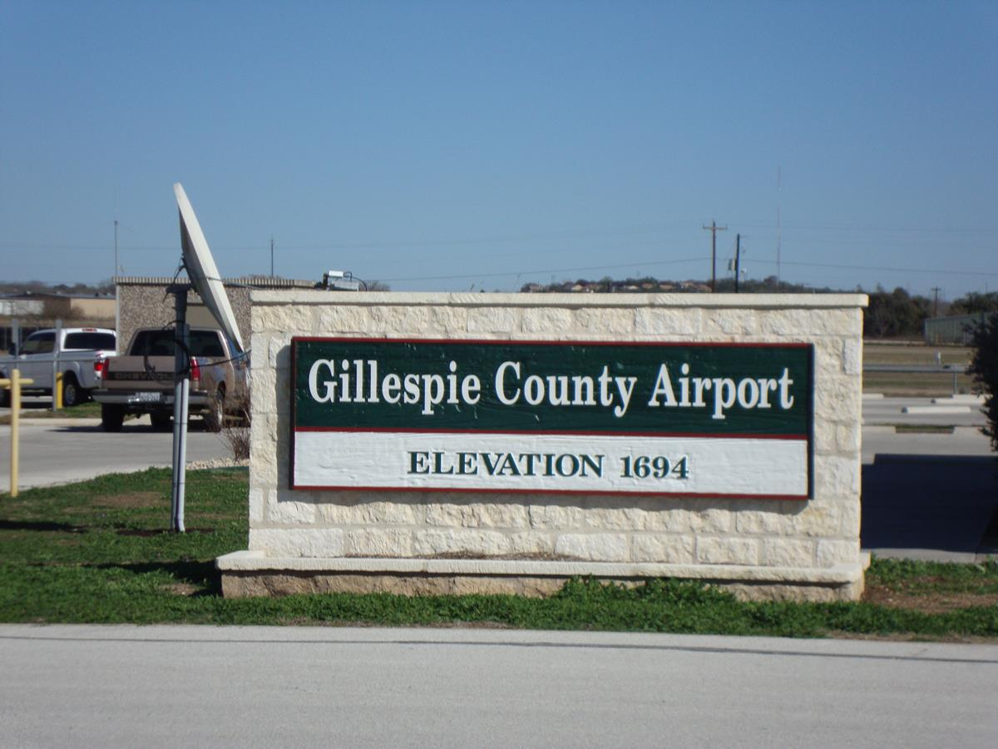
T82
Hangar hotel

Slide 5
Airport information
T82 is on the San Antonio sectional
Non-towered
5,000’ runway with parallel taxiway
1700’ elevation
2 RNAV approaches
1 VOR approach

Slide 6
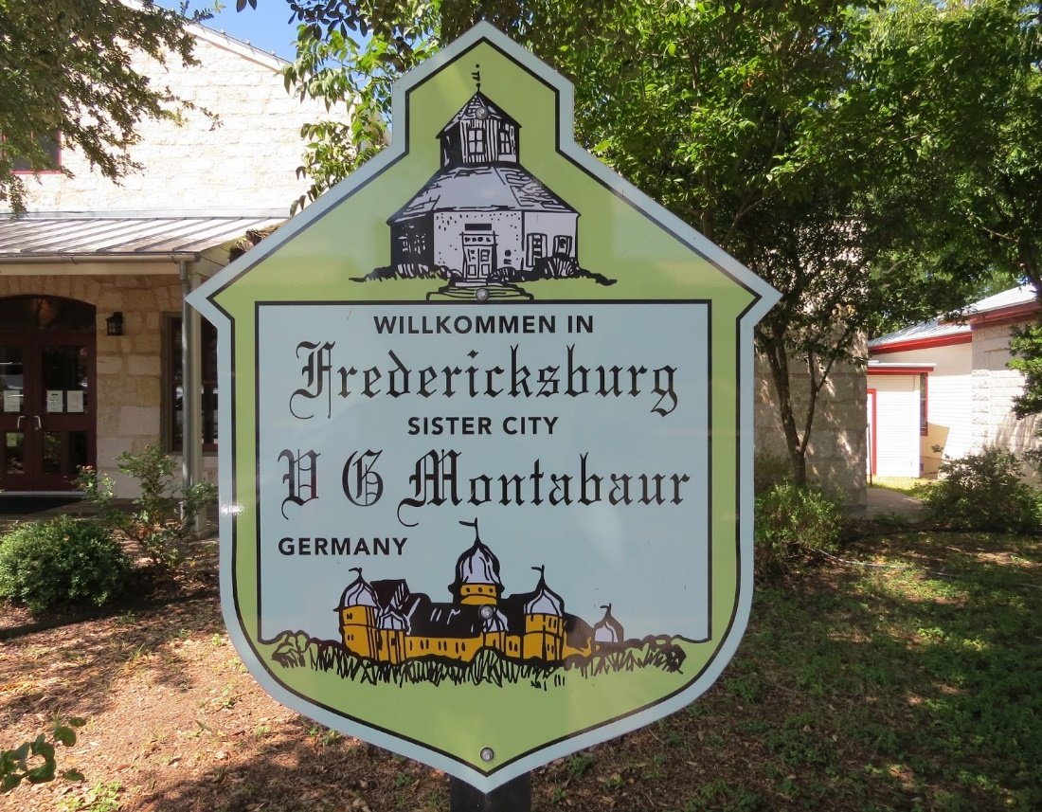
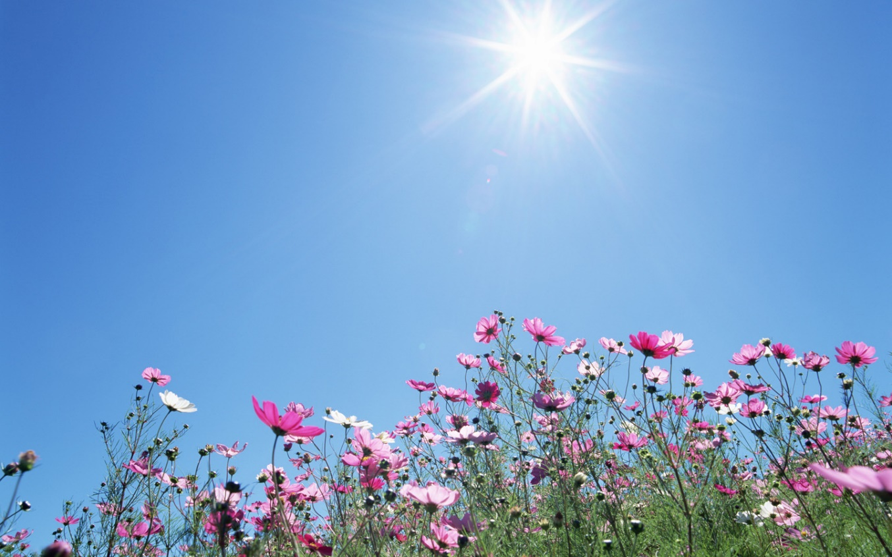
What about the weather?!?
Average Weather in May in Fredericksburg
Daily high temperatures 81°F to 86°F (27-30C)
rarely falling below 73°F or exceeding 92°F (23-33C)
Daily low temperatures 59°F to 66°F (15-19C)
rarely falling below 48°F or exceeding 72°F 9-22C)

Slide 7
Convention Hotel
Hangar Hotel

Slide 8
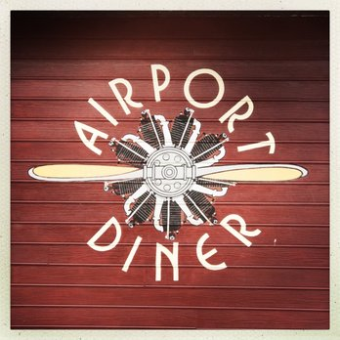
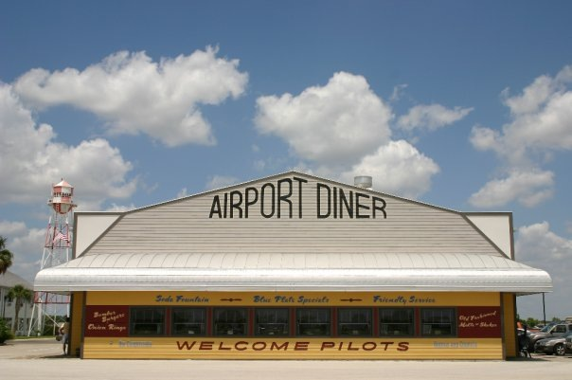

Slide 10
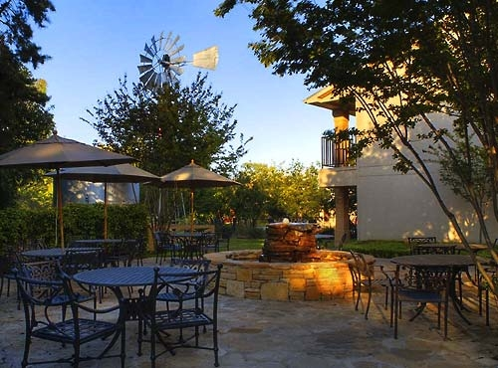
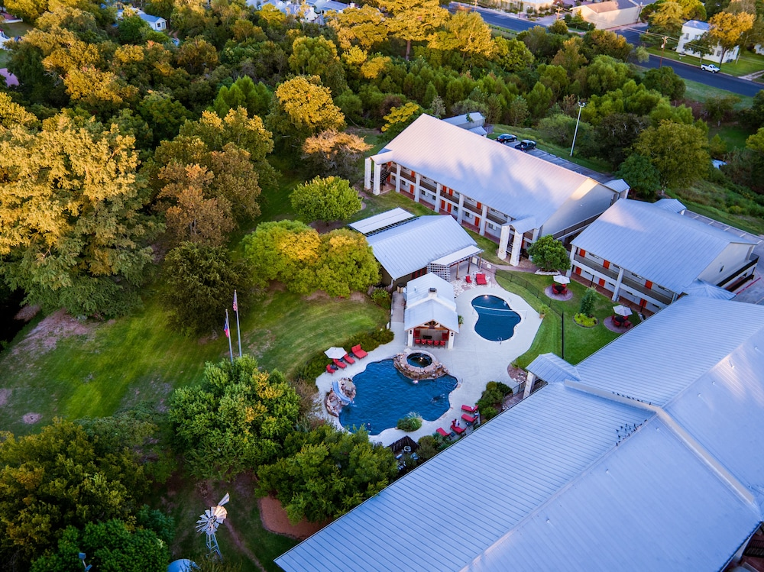
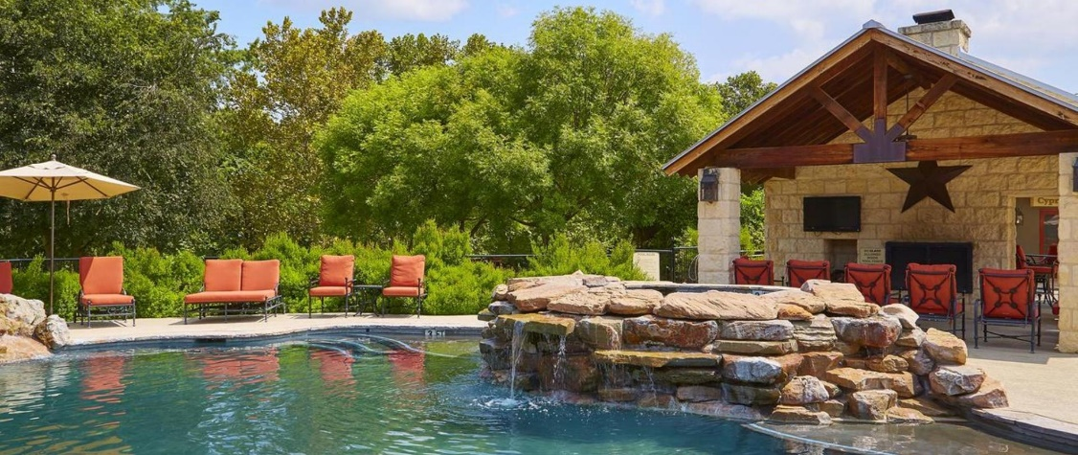
Overflow Hotel –
Fredericksburg Inn & Suites
2 blocks from main street

Slide 11
Things to Do, Places to Go, People to See in the Texas Hill Country!

Slide 12
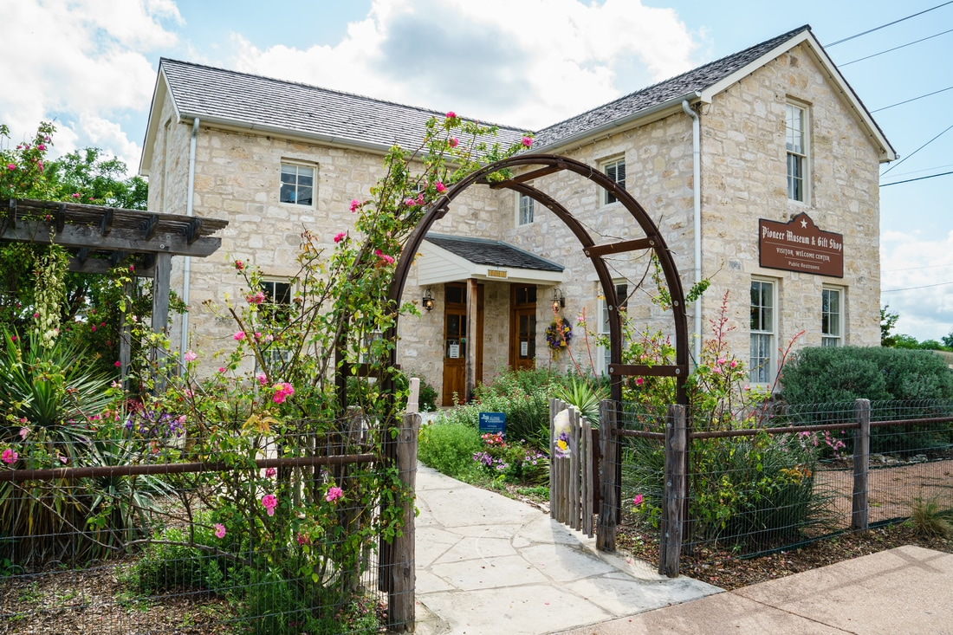
National Museum
of the Pacific War
Pioneer Museum

Slide 13
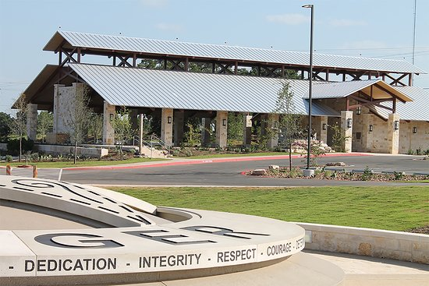
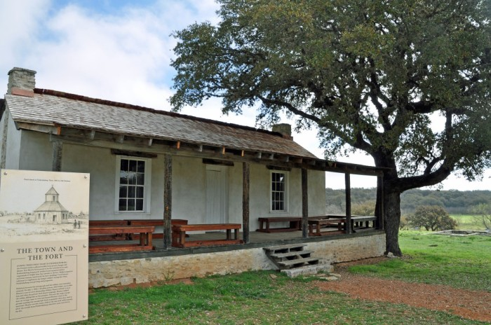
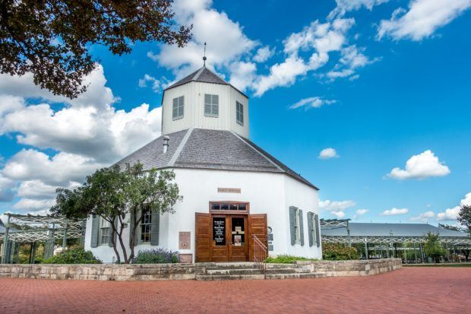
Texas Rangers Heritage Center
Fort Martin Scott
Vereins Kirche Museum

Slide 14
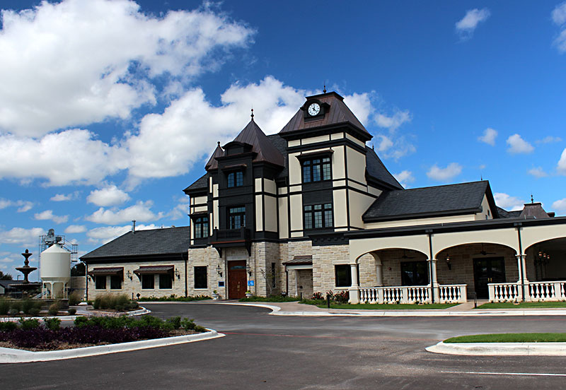
Optional Wednesday afternoon tour starts with lunch at Alstadt Brewery…

Slide 15
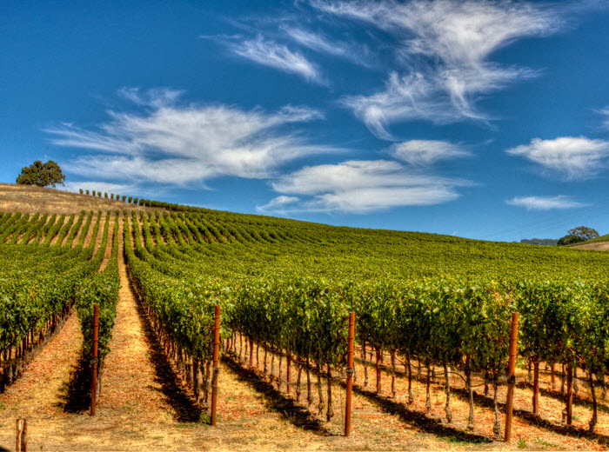
Followed by an afternoon tour of the Texas Wine Country…

Slide 16
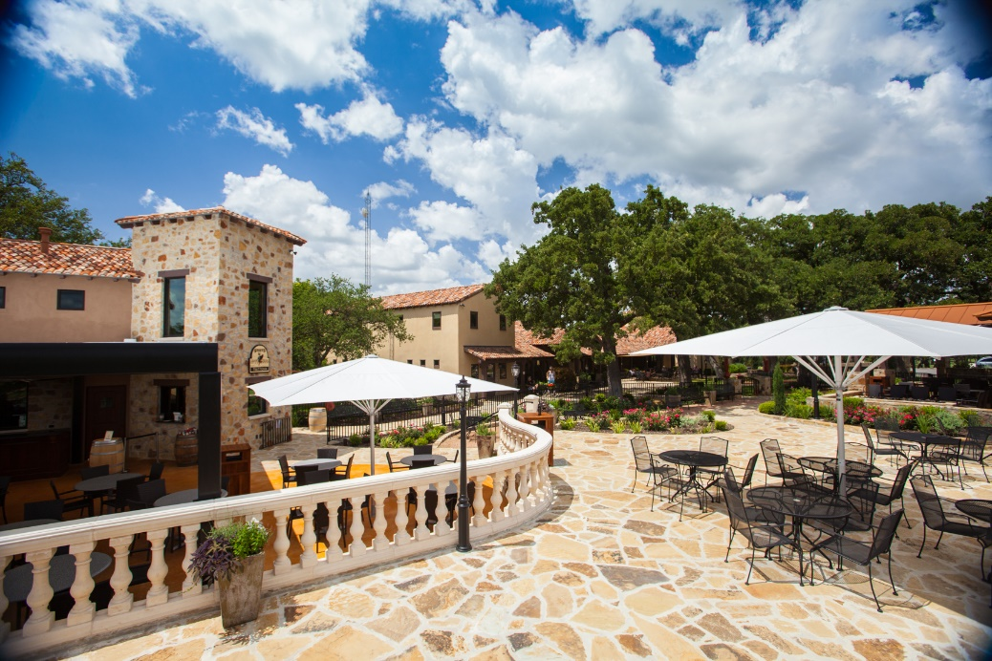
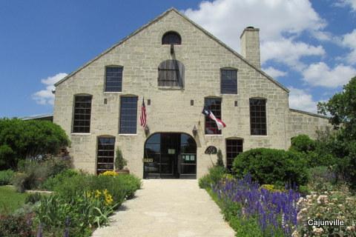
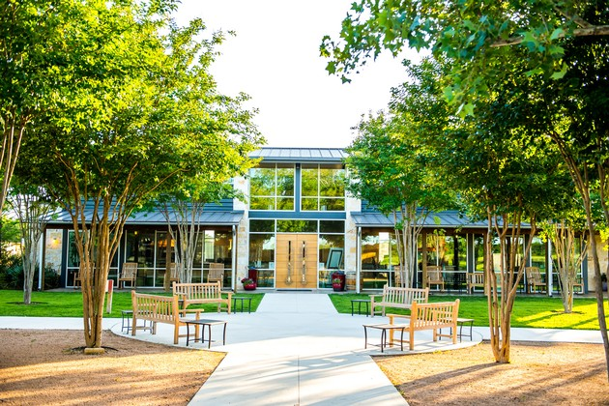
With stops at Grape Creek Vineyards
Becker
Vineyards
4.0 Cellars

Slide 17
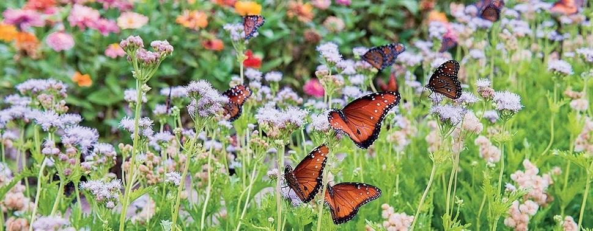
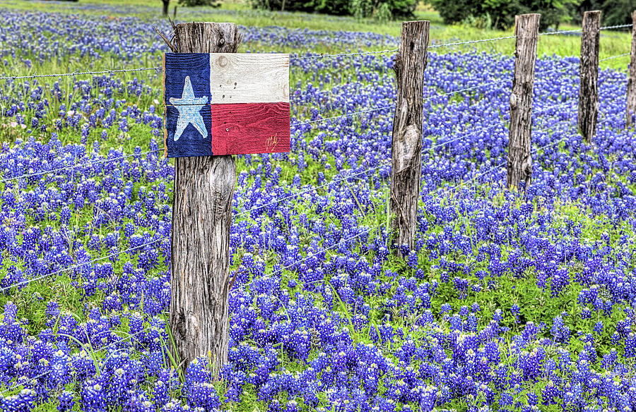
And the
Wildseed Farm

Slide 18
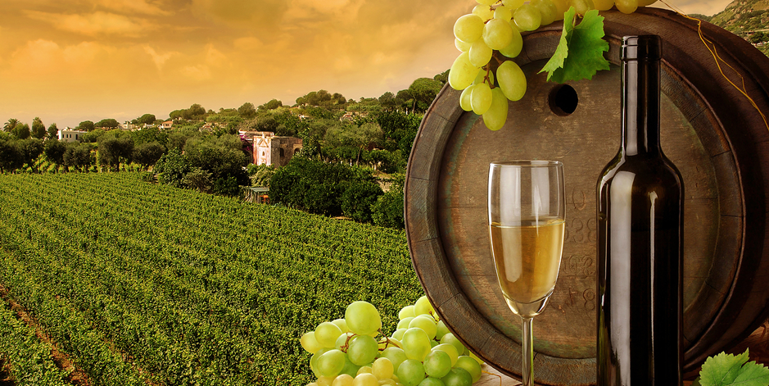
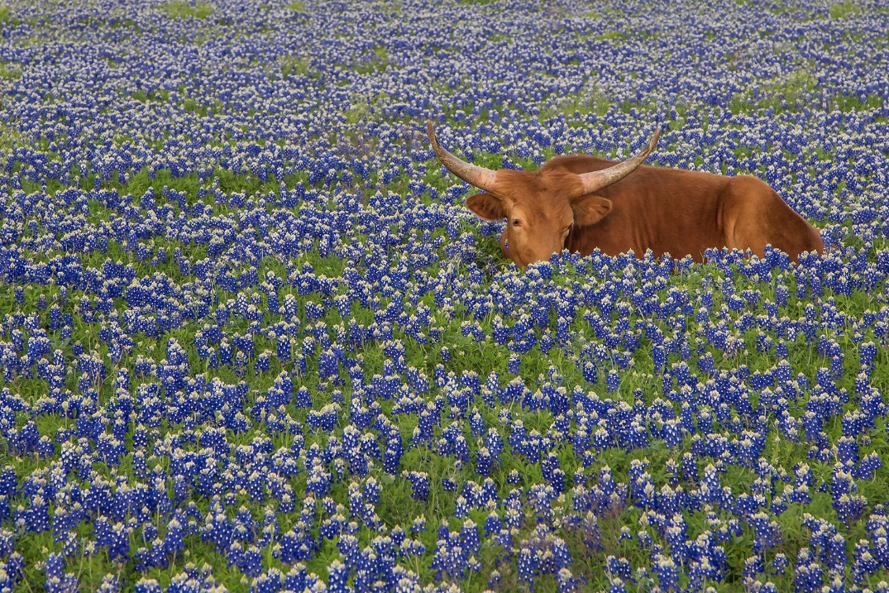
Yes, this really is
the Texas Hill Country!

Slide 19
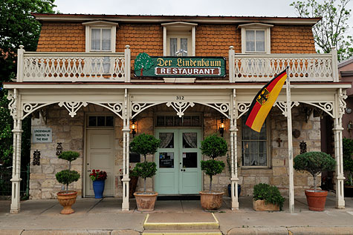
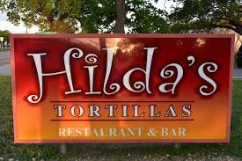
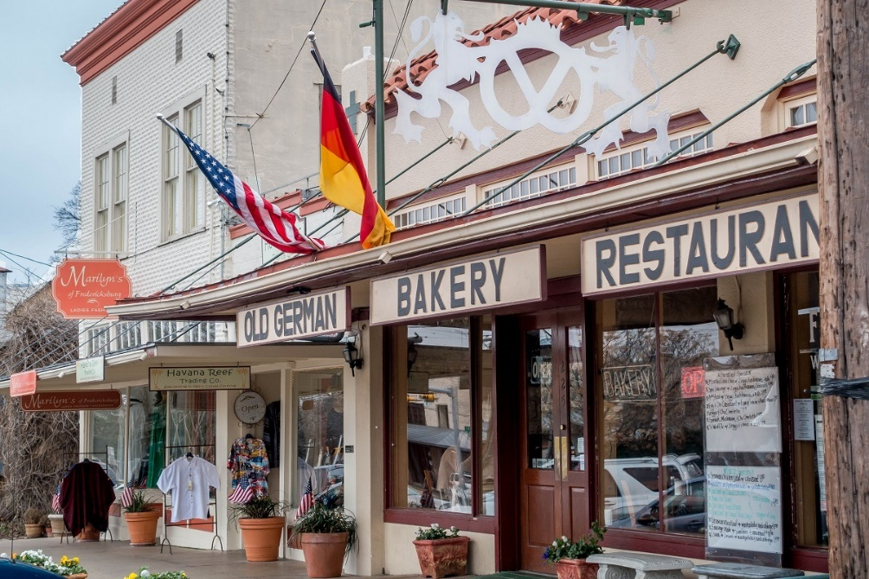
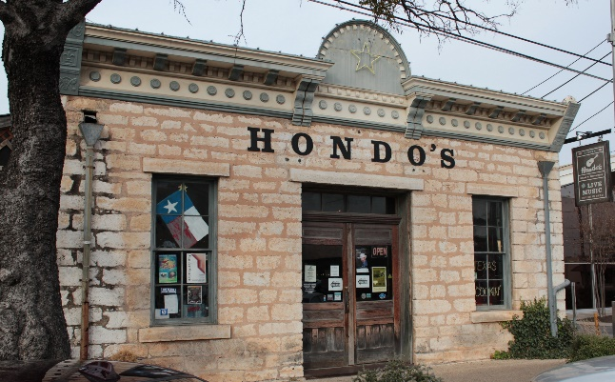
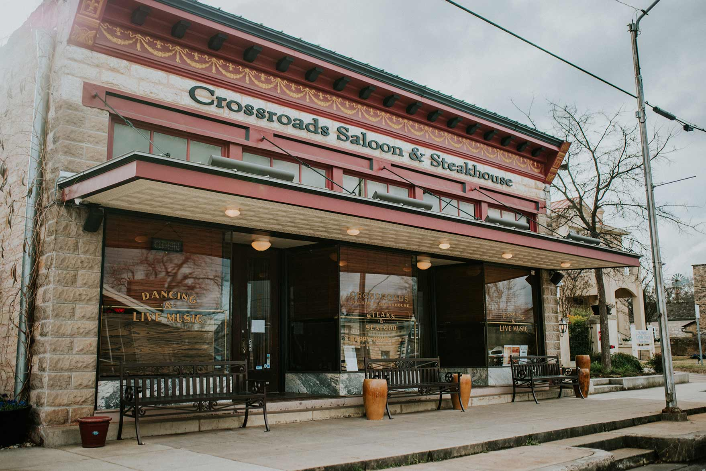
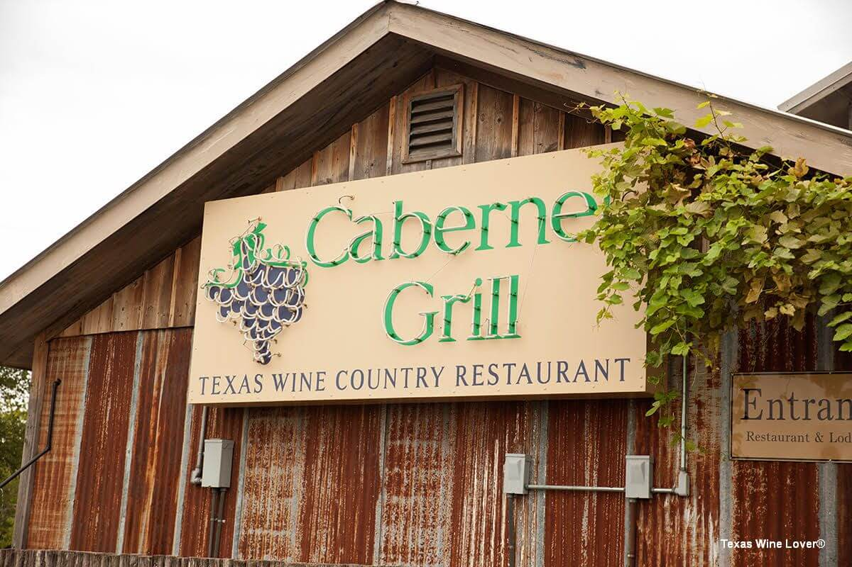
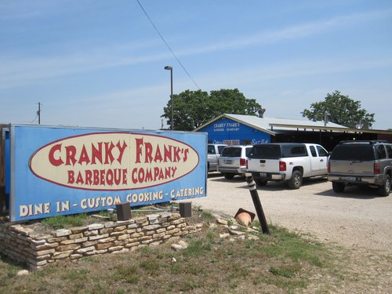
Plenty of places to eat
All kinds of food!

Slide 20
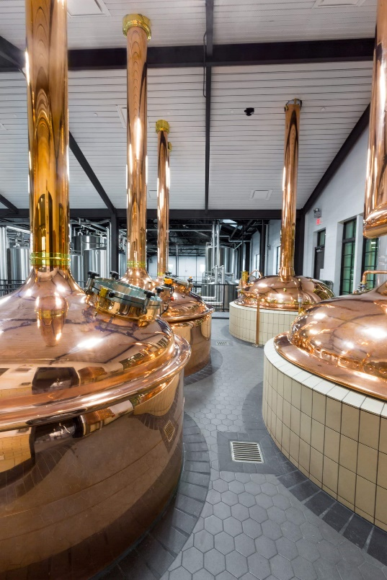
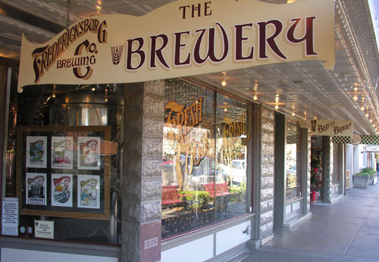
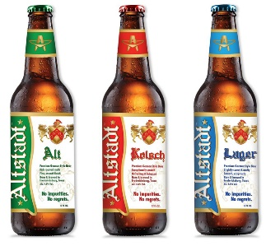
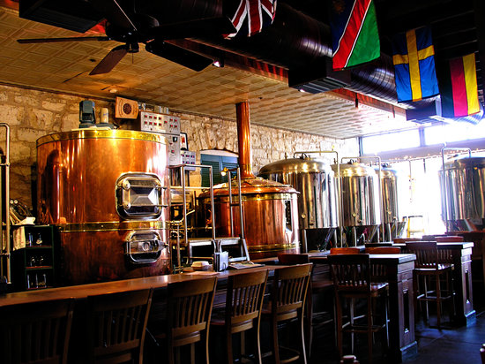
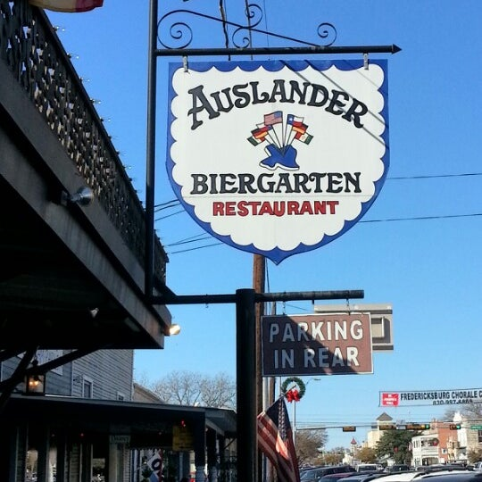
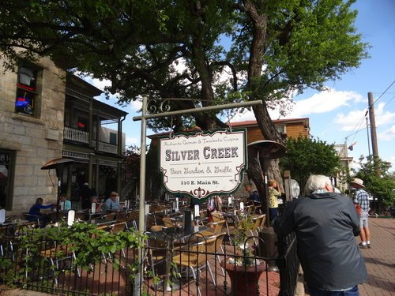
Plenty of places to try local beers!

Slide 21
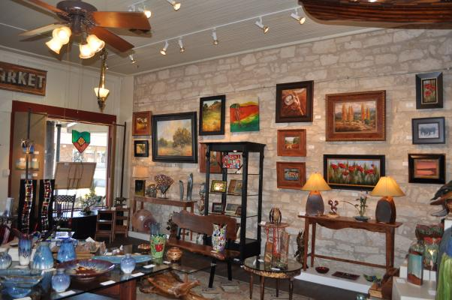
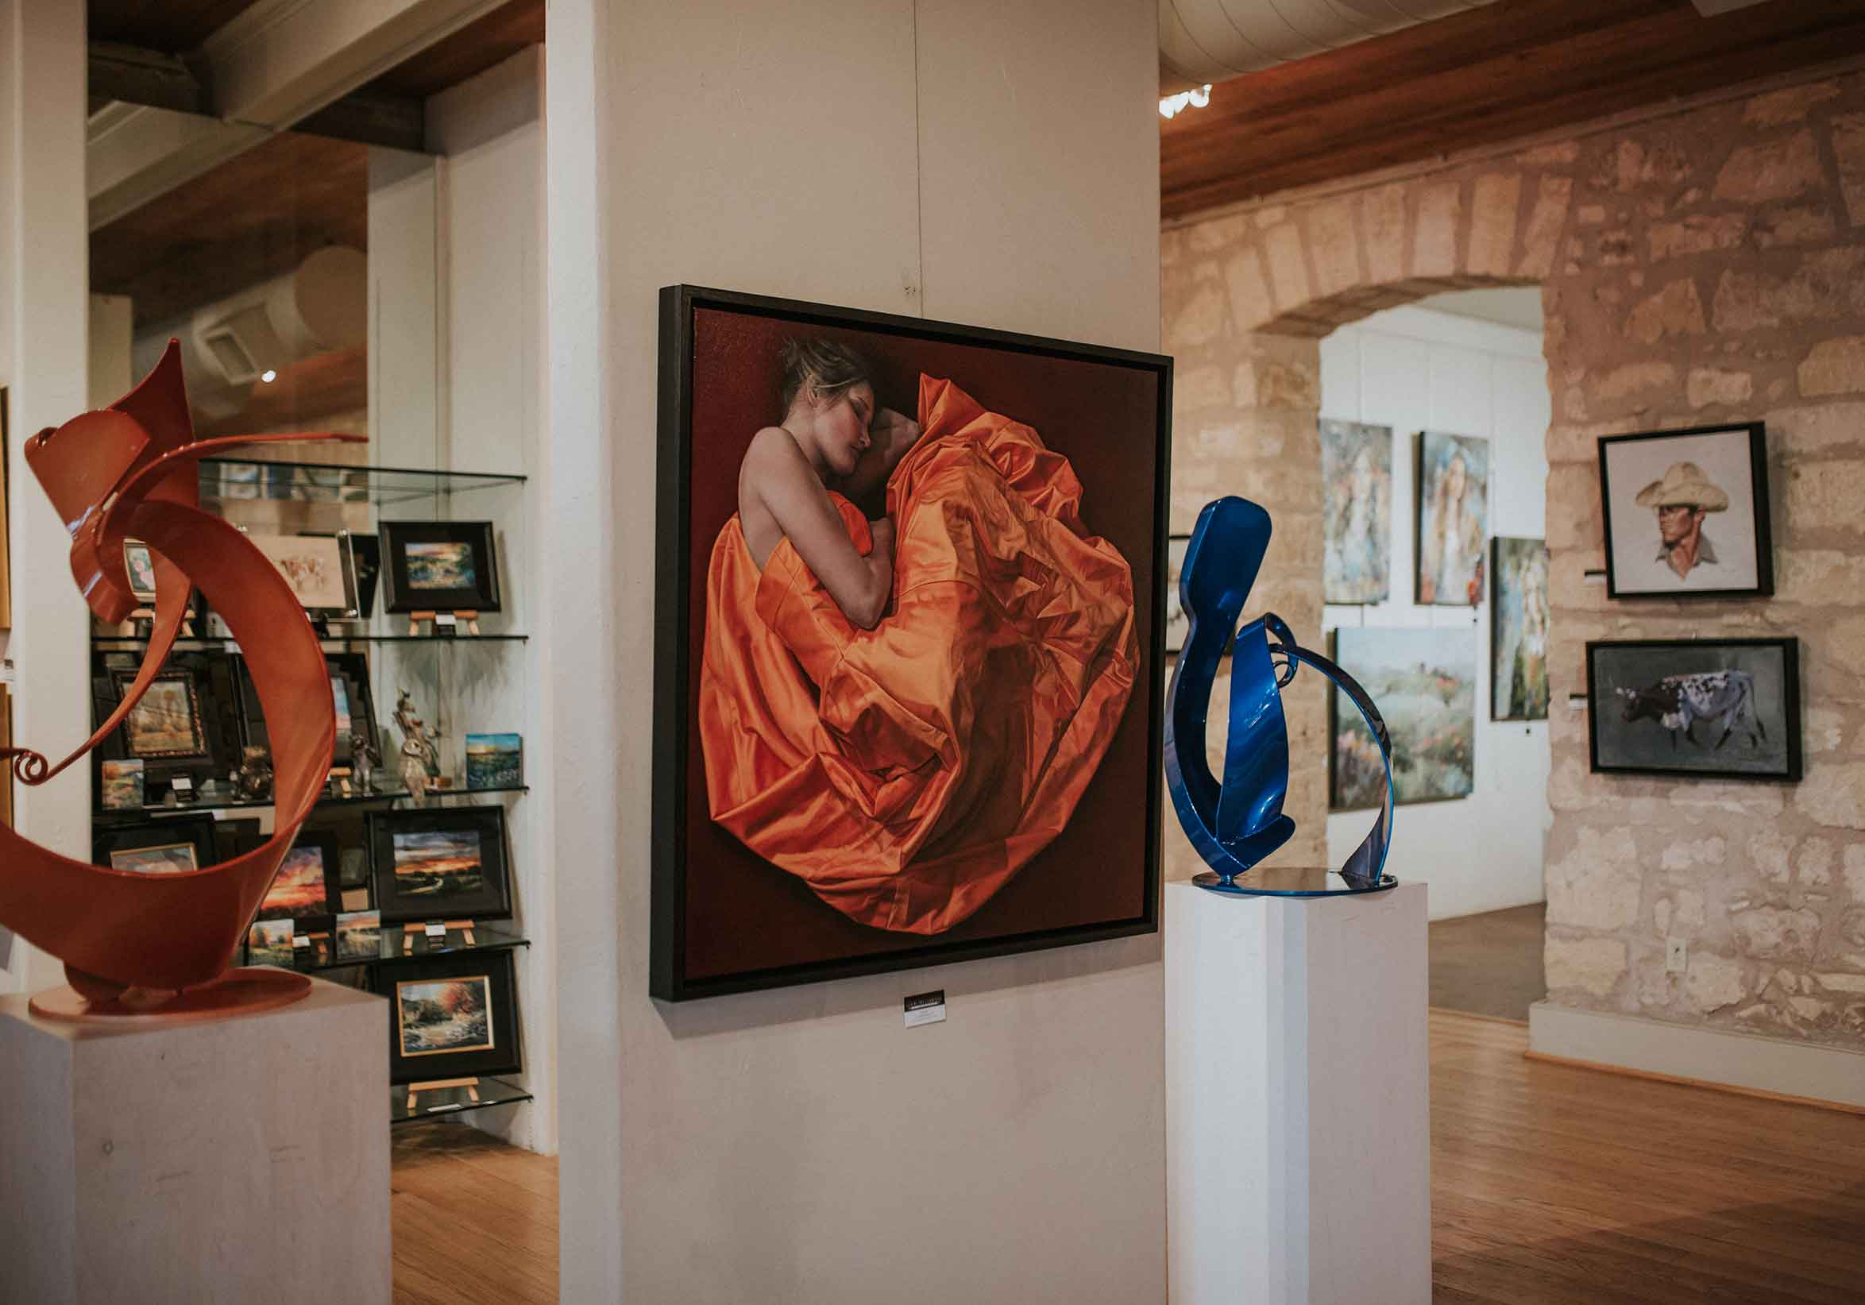
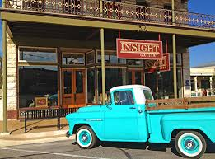
Art galleries galore!

Slide 22
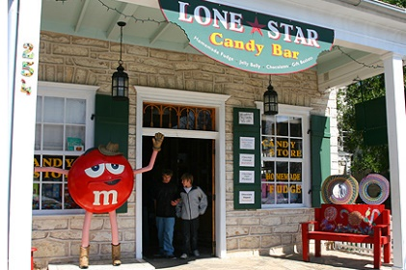
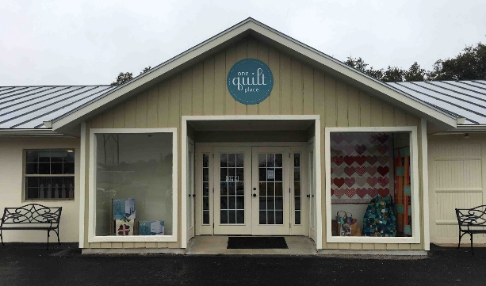
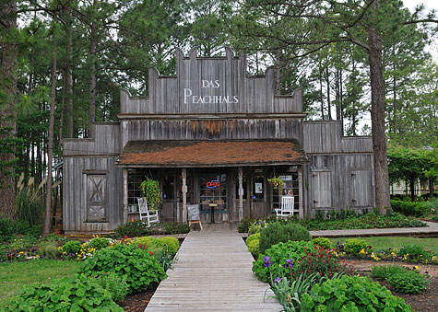
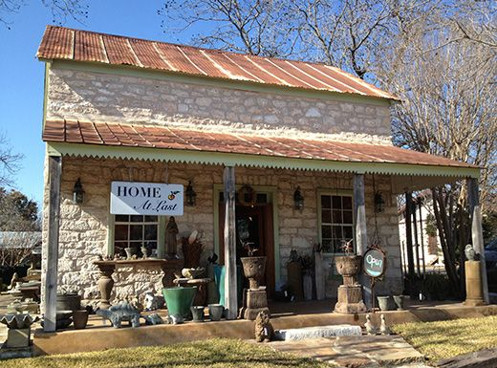
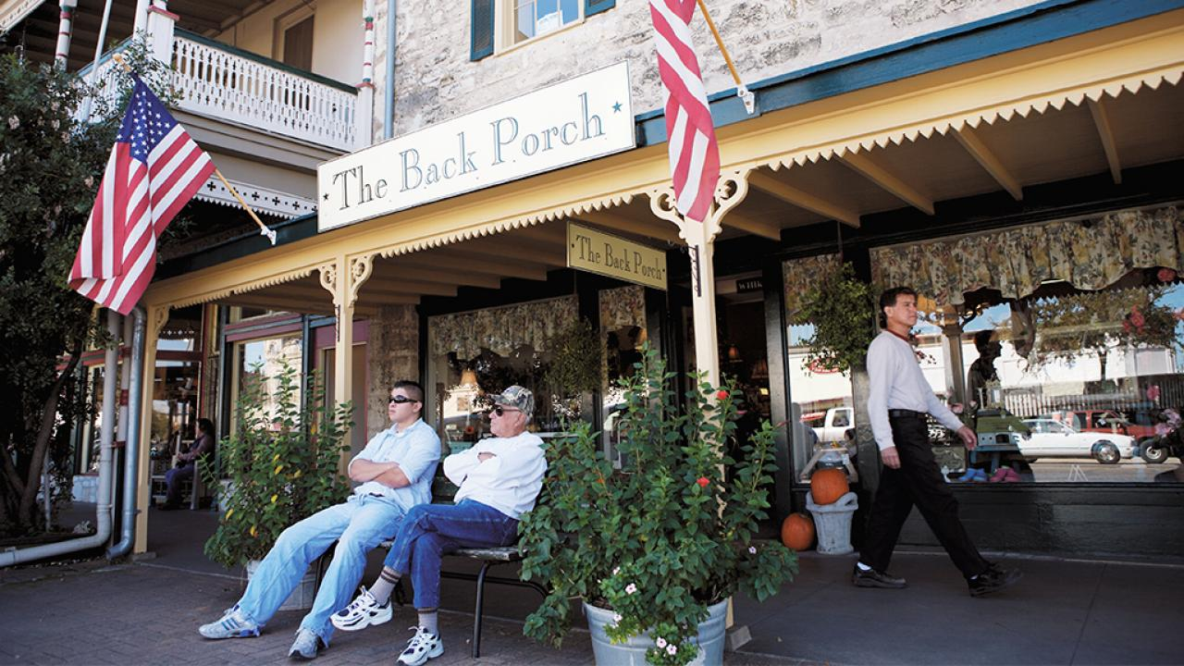
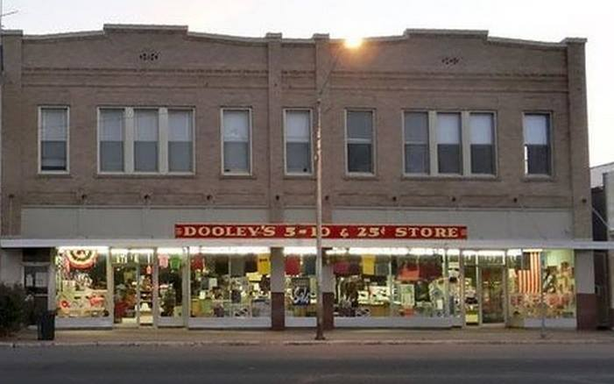
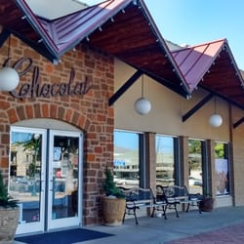
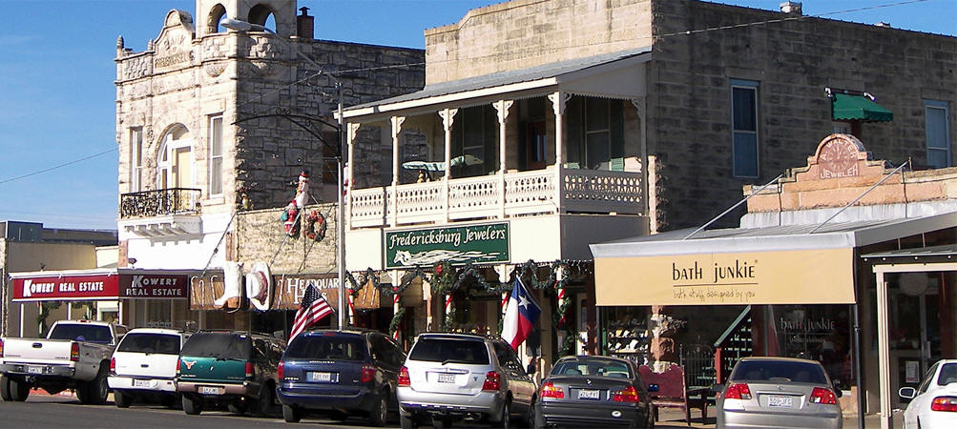
Shop till you drop!

Slide 23
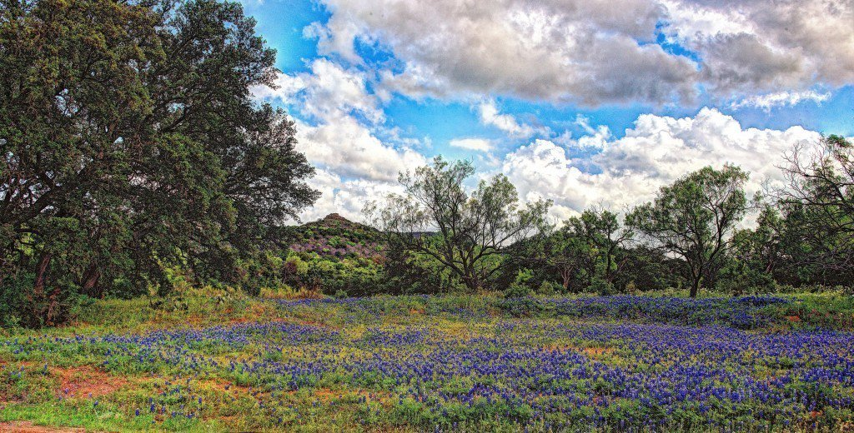
Area Attractions

Slide 24
Enchanted Rock State Natural Area

Slide 25
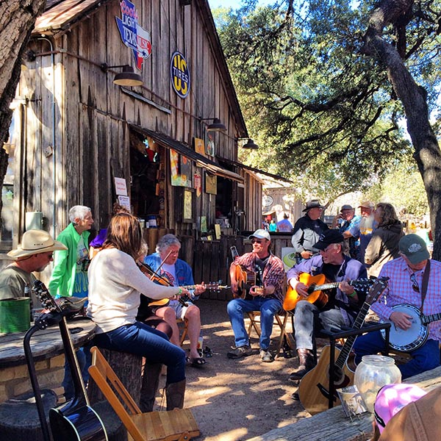
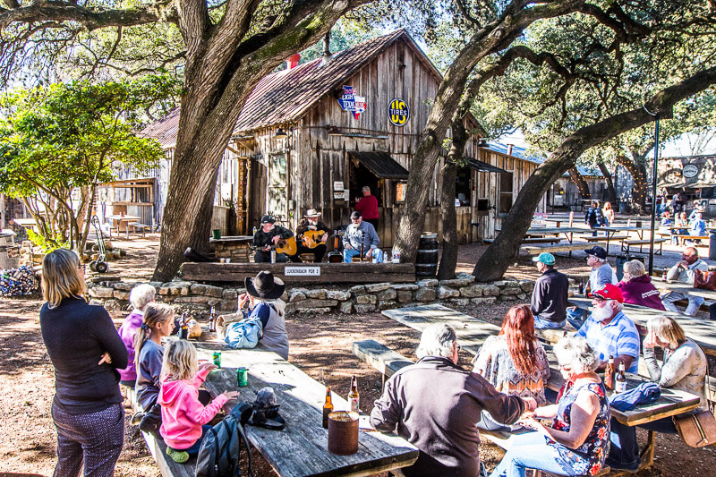
Luckenbach, Texas
Picker circles, shows, and dances!

Slide 26
Old No. 9 Tunnel State Park bat cave - home to millions of Mexican freetail bats
nearby - Alamo Springs Cafe

Slide 27
Texas White House &
Boyhood home of LBJ
in nearby Johnson City

Slide 28
Garrison Brothers Distillery
in nearby Hye, Texas

Slide 29
See you in Fredericksburg in May, 2020!

Slide 30
Wir freuen uns, Sie in Texas zu sehen!
Ihre Tagung ist Gastgeber von Scott, Susan, Bill und Cindy

